Slide 1
UNIT-1
EMBEDED COMPUTING

Slide 2
Introduction
We have been brought up in the age of computing.
Computers are everywhere, some we see, some we don’t see.
Types of computers we are familiar with
desktop and laptops.
servers
mobile phones
But there is another type of computing system that is often hidden……
EMBEDDED SYSTEMS

Slide 3
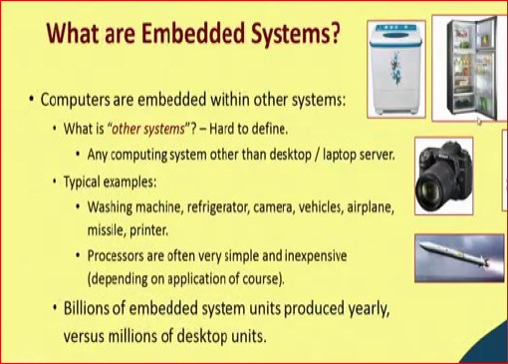

Slide 4
Desktop can compute, a laptop can compute, a mobile phone can also compute in some sense. But if you look at a refrigerator, if we look at our air conditioning machine, do they look like a computing machine? No.
But inside those machines there is some computing brain hidden. These are far
more common in our daily life and pervasive, as they are everywhere, they are hidden in the environment for which they were created

Slide 5
such systems are traditionally referred to as embedded systems.
We mean these are computing systems, but they are embedded inside the environment.
environment we mean the surroundings or actually the scenario for which the system was designed.

Slide 6
Take the example of an air conditioning machine.
An AC machine is supposed to be housed inside a room normally. Now this computing system that is sitting inside an AC machine, for that computing system the AC machine is the environment. It does not interact with anybody outside that AC machine.
Notes:
Reference: NPTEL,IIT,kharagpur

Slide 7
It is responsible for controlling the AC machine, it is responsible for responding to whatever you are pressing on your remote control, you are given giving some commands to the ac machine and so on. These are the kind of commands that those computing machines inside are responsible to respond to.

Slide 8
For some applications you do not need too much computation power, but for a system like missile lot of computations need to take place in real time. As the missile flows in its trajectory, there is continuous feedback from the environment and there are some corrective actions that need to be taken such that the missile can follow the correct path and hit the target in a precise way.

Slide 9
“other systems” can refer to anything, it is
very hard to define in a very specific way. But broadly speaking you can say that these other systems are any computing system, which are not our conventional computers like desktop, laptop, servers etc.

Slide 10
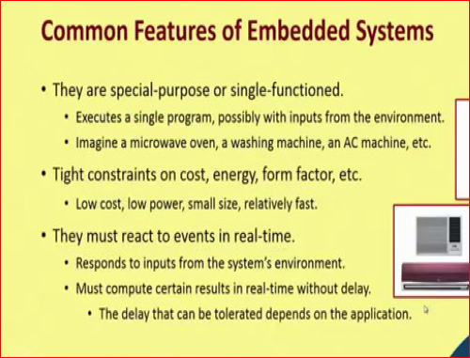

Slide 11
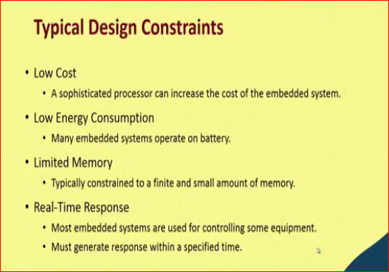

Slide 12
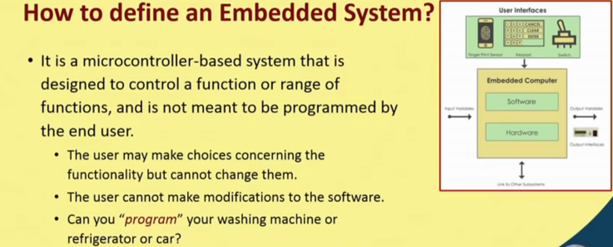

Slide 13
Most of the embedded systems have microcontrollers inside them, they are like a complete computer in a single chip. Whatever you need, processor, memory, IO everything is inside a single chip and therefore, it is very low cost. So, it should be a microcontroller based system and not general purpose.

Slide 14
What embedded system is not…..
A microprocessor sitting inside a traditional computing system.
It is actually
A microprocessor used to control another piece of technology.
For low cost, microcontrollers that are typically used are single chip devices containing processor, memory, and I/O interfaces.
Notes:
Slides from :Embedded System Design with ARM
Prof. Indranil Sengupta
Department of Computer Science and Engineering
Indian Institute of Technology, Kharagpur

Slide 15
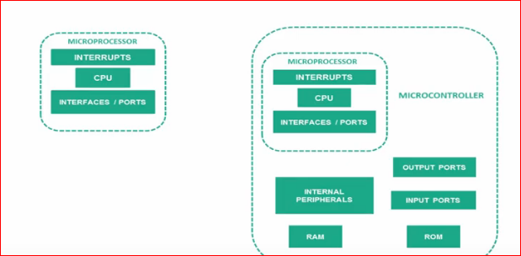

Slide 16
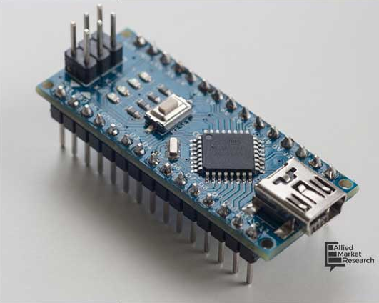

Slide 17
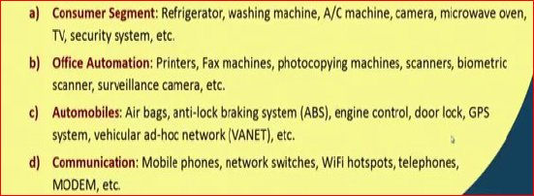
Applications of embedded systems

Slide 18
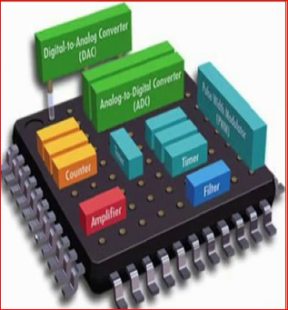

Slide 19
What is embedded computer????
Any device that includes a programmable computer but not for general purpose.

Slide 20
Computer hardware systems having software embedded in it.
Are designed for specific task.
Software embedded is normally referred as firmware, because it is stored on chip.
Hardware: Microprocessor or microcontroller.

Slide 21
Microprocessor : CPU but use external chips for memory.
ex: DSP: Digital signal processor-used for processing audio and image files.
automobile may have 100 microprocessors.
Microcontroller : written to perform specific function.
Software: code in hex code ( rarely used ).
Programming languages ( C or C++ )

Slide 22
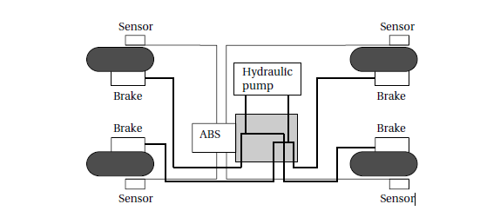
BMW brake system.

Slide 23
ABS- antilock Brake system.
ASC+T – Automatic stability control.
ABS:
Temporarily release the brake on a wheel when it rotates too slowly.
Uses sensors on each wheel to measure the speed of the wheel.
Control the hydraulic fluid pressure to prevent the wheels from skidding.
ASC+T:
Controls engine power and brake.
Two microprocessors on PCB.

Slide 24
Characteristics of embedded computing applications.
Functionality: complex algorithm, User interface.
Time:Real time applications.
video conferencing, online gaming.
Cost : Manufacturing cost.
depends on type of processors used, memory, type of I/O devices.
power and energy :
larger power supply may require.
energy consumption affects battery life.

Slide 25
Why use microprocessors???
Flexible.: predesigned instruction set-faster execution.
Efficient : several instructions are executed per cycle.
Highly optimized:
Programmability : somewhat depend on hardware that is number of registers, capacity etc…according to that they have to write programs.
Real time : achieved my microprocessors.
Low power and low cost.

Slide 26
Challenges in embedded computing system design.
How much hardware do we need.
How do we meet deadlines.
How do we minimize power consumption.
How do we design for upgradeability.
Does it really work– reliability.
Until unless you install and work on real time you cant get an idea.

Slide 27
Challenges in embedded computing system design.
Complex testing: to test embedded systems, real time data should be gathered.
Limited observability and controllability.
E.C.Systems do not come with keyboards and screens.
this makes it more difficult to see what is going on inside the system.
Restricted development environment.
compile and run cant be on the same machine.
compile code on one type of machine, PC, and download it into the embedded system.

Slide 28
Performance of embedded computing systems.
Program must meet its deadlines.
Real time computing.

Slide 29
Components of ES
CPU
Platform
progrAM
TASK
MULTIPROCSSOR

Slide 30
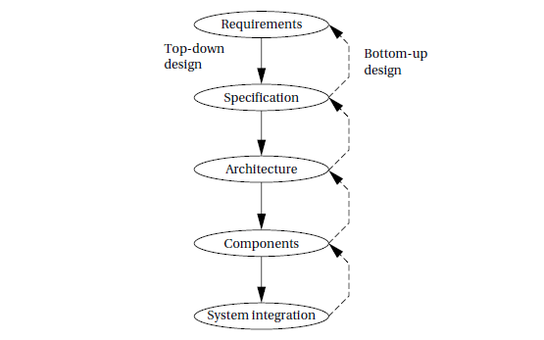
Embedded system design process

Slide 31
Major goals of the design
Manufacturing cost.
Performance(speed and deadline ).
Power consumption.

Slide 32
Task to perform at each step.
Analyze the design.
how we can meet the specification.
Refine the design.
add more detail.
Verify the design.
check whether it meets all system goals, cost, speed and so on.

Slide 33
Requirements
Know what you are designing.
Get requirements from customers.
Refine requirements into specification that helps in designing the system architecture.

Slide 34
Requirements vs specifications
Functional and non functional.
Functional requirements.
1) technical details.
Non functional requirements.
1) performance.
2) cost:-- manufacturing cost, nonrecurring engineering( other costs).
3) physical size and weight.
4) power consumption

Slide 35
Validating requirements
How people use and communicate with the system.
Mock-up test.
Get simple requirements form at the start of the project.

Slide 36
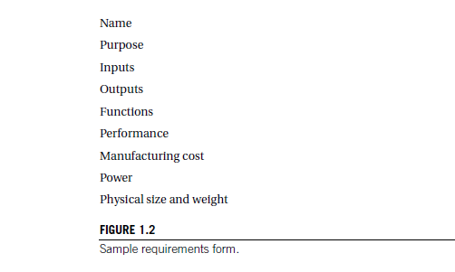

Slide 37
Name: name of the project.
Purpose : what the system is supposed to do.
Inputs and outputs:
1) types of data.—analog or digital.
2) characteristics: how many bits/sec etc.
3)types of I/O devices.: switches, converters, video displays??
4) functions: after receiving inputs what the system should do .
Performance: speed.
Manufacturing cost
Power :
Physical size and weight:

Slide 38
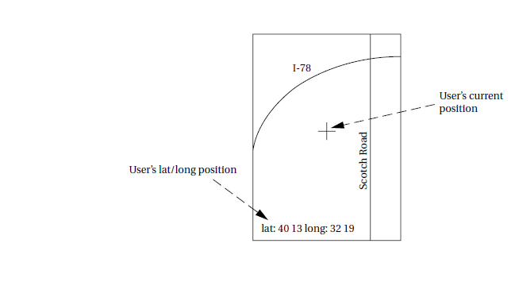
Requirement analysis of GPS ( Global positioning system ) moving map.

Slide 39
Functionality:
1) designed for highway driving and similar uses.
User interface:
1) at least 400 * 600 pixel resolution.
2) not more than 3 buttons.
3) menu system.
performance:
1) map should scroll smoothly.
2) display should take no more than one second to appear.
Cost:
Physical size and weight: device should fit comfortably in the palm of the hand

Slide 40
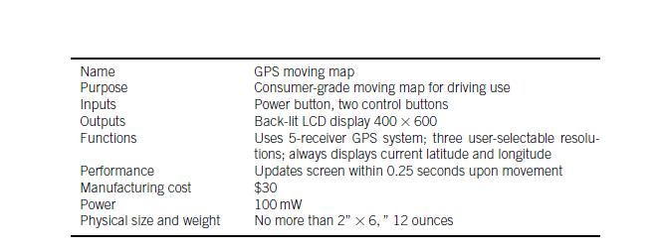
Power consumption: run for at least eight hours on four AA batteries.

Slide 41
specification
Should be understandable.
Designers can run into several different types of problems.

Slide 42
Specification of the gps system
Data received from the GPS satellite constellation.
Map data.
User interface.
Operations that must be performed to satisfy customer requests.
Background actions required to keep the system running, such as operating the GPS receiver.

Slide 43
Architecture design.
How the system does things.
Plan of for the overall structure of the system.

Slide 44
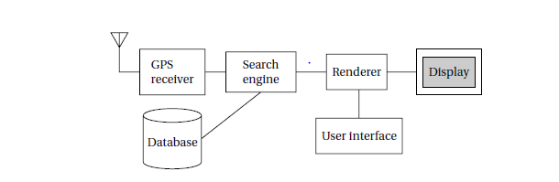
Moving map example.

Slide 45
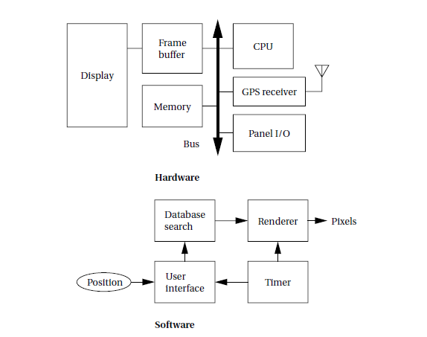
Hardware and software architecture for the moving map.

Slide 46
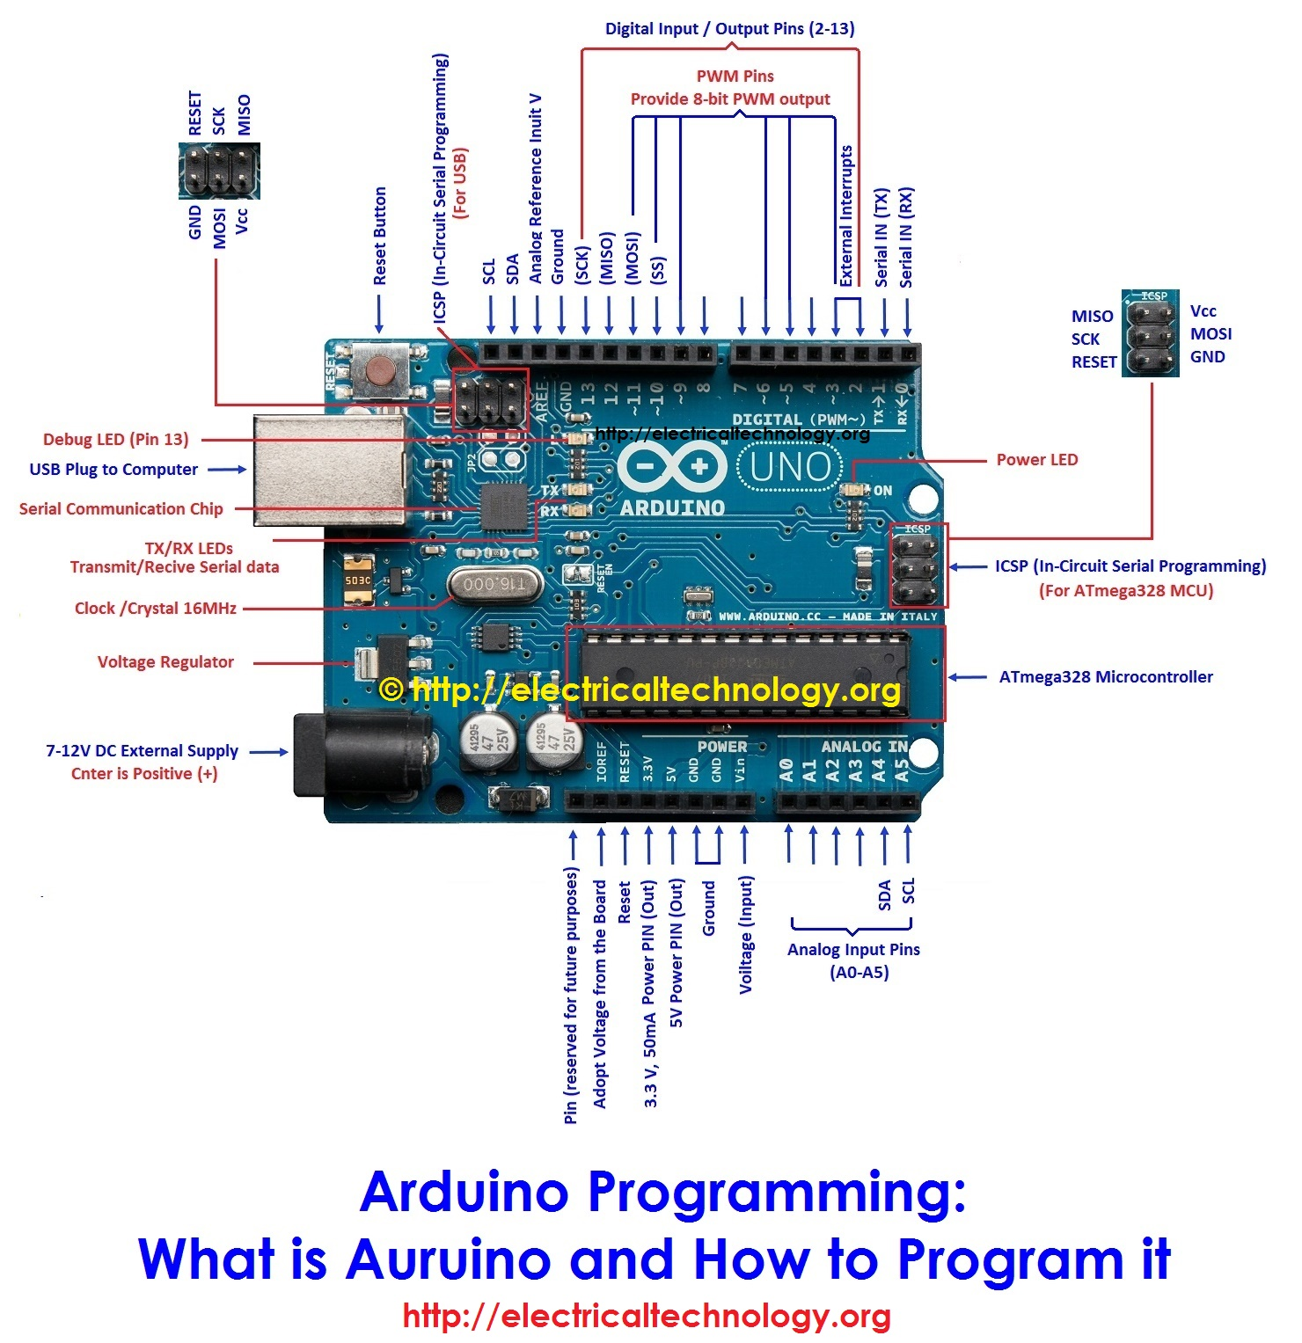
Experiment number 1: blinking led.

Slide 47
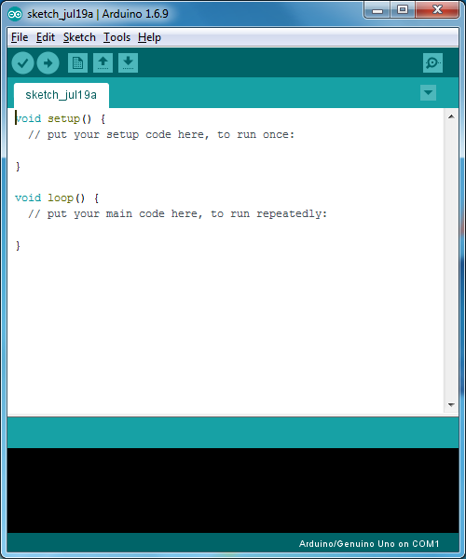
Simple Arduino Skecth in GUI

Slide 48
Blinking an LED -application
void setup()
{ pinMode(13, OUTPUT); } void loop()
{ digitalWrite(13, HIGH); delay(1000); digitalWrite(13, LOW); delay(1000);
}

Slide 49
Configuration of Arduino
Windows
Device manager → ports → comp port number
Adrduino IDE → Tools → Port: number should match

